Slide 1
School of Computing Science and Engineering
Course Code : BTCS2401 Course Name: Computer Graphics
Basic illumination models :Ambient light and Diffuse reflection
Name of the Faculty: Suman Devi Program Name: B.Tech

Slide 2
School of Computing Science and Engineering
Course Code : BTCS2401 Course Name: Computer Graphics
Objective
Illumination model, also known as Shading model or Lightning model, is used to calculate the intensity of light that is reflected at a given point on surface. There are three factors on which lightning effect depends on:
Light Source : Light source is the light emitting source. There are three types of light sources:
i. Point Sources – The source that emit rays in all directions (A bulb in a room).
ii. Parallel Sources – Can be considered as a point source which is far from the surface (The sun).
Name of the Faculty: Suman Devi Program Name: B.Tech

Slide 3
School of Computing Science and Engineering
Course Code : BTCS2401 Course Name: Computer Graphics
iii. Distributed Sources – Rays originate from a finite area (A tubelight).
Their position, electromagnetic spectrum and shape determine the lightning effect.
2. Surface : When light falls on a surface part of it is reflected and part of it is absorbed. Now the surface structure decides the amount of reflection and absorption of light. The position of the surface and positions of all the nearby surfaces also determine the lightning effect.
3.Observer : The observer’s position and sensor spectrum sensitivities also affect the lightning effect.
Name of the Faculty: Suman Devi Program Name: B.Tech

Slide 4
School of Computing Science and Engineering
Course Code : BTCS2401 Course Name: Computer Graphics
1.Ambient Light :
Assume you are standing on a road, facing a building with glass exterior and sun rays are falling on that building reflecting back from it and the falling on the object under observation. This would be Ambient Light. In simple words, Ambient Illumination is the one where source of light is indirect.
. Even though an object in a scene is not directly lit it will still be visible. This is because light is reflected indirectly from nearby objects. A simple hack that is commonly used to model this indirect illumination is to use of an ambient light source.
Name of the Faculty: Suman Devi Program Name: B.Tech

Slide 5
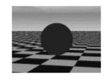
School of Computing Science and Engineering
Course Code : BTCS2401 Course Name: Computer Graphics
Ambient light has no spatial or directional characteristics. The amount of ambient light incident on each object is a constant for all surfaces in the scene. An ambient light can have a color.
. The amount of ambient light that is reflected by an object is independent of the object's position or orientation. Surface properties are used to determine how much ambient light is reflected.
Name of the Faculty: Suman Devi Program Name: B.Tech

Slide 6
School of Computing Science and Engineering
Course Code : BTCS2401 Course Name: Computer Graphics
Ambient intensity :-
The ambient intensity is the light available in the environment. There is no particular direction to the light source. ... The light intensity affects the intensity of the highlights and shadows, while the ambient intensity affects the brightness of the objects in the overall scene.
Working :-
The main lights that you use to light up the room as a whole can usually be included within this lighting category. Ambient light also tends to set the tone for the room. The level of ambient lighting will dictate whether a room is bright, homey, a bit darker or more relaxed
Name of the Faculty: Suman Devi Program Name: B.Tech

Slide 7
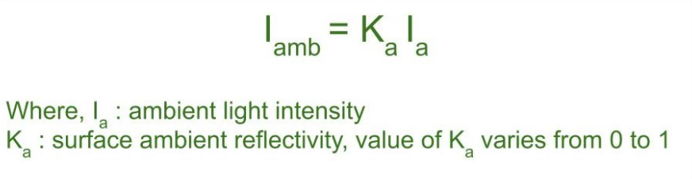
School of Computing Science and Engineering
Course Code : BTCS2401 Course Name: Computer Graphics
Diagram of Ambient Light
The reflected intensity I_{amb} of any point on the surface is:
Name of the Faculty: Suman Devi Program Name: B.Tech

Slide 8
School of Computing Science and Engineering
Course Code : BTCS2401 Course Name: Computer Graphics
2.Diffuse Reflection
Diffuse reflection occurs on the surfaces which are rough or grainy. In this reflection the brightness of a point depends upon the angle made by the light source and the surface. Diffuse reflection is the reflection of light or other waves or particles from a surface such that a ray incident on the surface is scattered at many angles rather than at just one angle as in the case of specular reflection. An ideal diffuse reflecting surface is said to exhibit Lambertian reflection, meaning that there is equal luminance when viewed from all directions lying in the half-space adjacent to the surface.
Name of the Faculty: Suman Devi Program Name: B.Tech

Slide 9
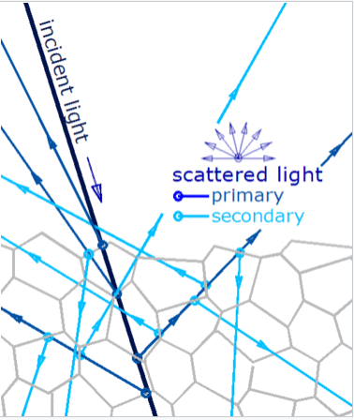
School of Computing Science and Engineering
Course Code : BTCS2401 Course Name: Computer Graphics
The most general mechanism by which a surface gives diffuse reflection does not involve exactly the surface: most of the light is contributed by scattering centers beneath the surface
Name of the Faculty: Suman Devi Program Name: B.Tech

Slide 10
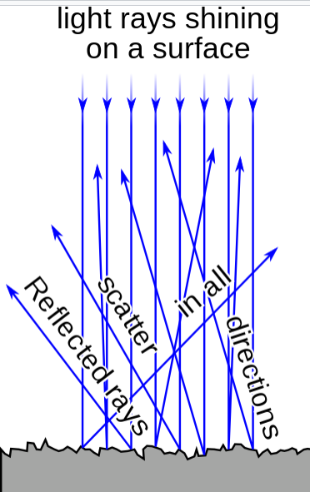
School of Computing Science and Engineering
Course Code : BTCS2401 Course Name: Computer Graphics
This mechanism is very general, because almost all common materials are made of "small things" held together. Mineral materials are generally polycrystalline: one can describe them as made of a 3D mosaic of small, irregularly shaped defective crystals.
Name of the Faculty: Suman Devi Program Name: B.Tech

Slide 11
School of Computing Science and Engineering
Course Code : BTCS2401 Course Name: Computer Graphics
.A surface built from a non-absorbing powder such as plaster, or from fibers such as paper, or from a polycrystalline material such as white marble, reflects light diffusely with great efficiency. Many common materials exhibit a mixture of specular and diffuse reflection. Diffuse reflection from solids is generally not due to surface roughness.
.A flat surface is indeed required to give specular reflection, but it does not prevent diffuse reflection. A piece of highly polished white marble remains white; no amount of polishing will turn it into a mirror. Polishing produces some specular reflection, but the remaining light continues to be diffusely reflected.
Name of the Faculty: Suman Devi Program Name: B.Tech

Slide 12
School of Computing Science and Engineering
Course Code : BTCS2401 Course Name: Computer Graphics
Colored objects:-
Diffusion affects the color of objects in a substantial manner because it determines the average path of light in the material, and hence to which extent the various wavelengths are absorbed.^{[6]} Red ink looks black when it stays in its bottle. Its vivid color is only perceived when it is placed on a scattering material (e.g. paper). This is so because light's path through the paper fibers (and through the ink) is only a fraction of millimeter long. However, light from the bottle has crossed several centimeters of ink and has been heavily absorbed, even in its red wavelengths
Name of the Faculty: Suman Devi Program Name: B.Tech

Slide 13
School of Computing Science and Engineering
Course Code : BTCS2401 Course Name: Computer Graphics
And, when a colored object has both diffuse and specular reflection, usually only the diffuse component is colored. A cherry reflects diffusely red light, absorbs all other colors and has a specular reflection which is essentially white (if the incident light is white light). This is quite general, because, except for metals, the reflectivity of most materials depends on their refractive index, which varies little with the wavelength (though it is this variation that causes the chromatic dispersion in a prism), so that all colors are reflected nearly with the same intensity.
Name of the Faculty: Suman Devi Program Name: B.Tech

Slide 14

School of Computing Science and Engineering
Course Code : BTCS2401 Course Name: Computer Graphics
Diffuse reflections from different light directions.
Name of the Faculty: Suman Devi Program Name: B.Tech

Slide 15
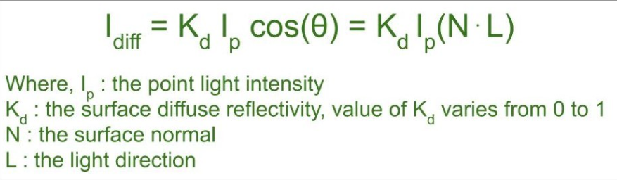
School of Computing Science and Engineering
Course Code : BTCS2401 Course Name: Computer Graphics
The reflected intensity I_{diff} of a point on the surface is:
Name of the Faculty: Suman Devi Program Name: B.Tech

Slide 16
School of Computing Science and Engineering
Course Code : BTCS2401 Course Name: Computer Graphics
Reference :
1 . Donald Hearn and M Pauline Baker, “Computer Graphics C Version”, Pearson Education, India; 2 edition 2002.
2. Computer Graphics Principles and Practice, Second Edition in C, James D.Foley, Andries Van Dam, Steven K.Feiner, JhonF.Hughes, Addison Wesley, Third Edition, 2014.
3. Steven Harrington, “Computer Graphics: A Programming Approach” , McGraw-Hill Inc.,US; 2nd Revised edition, 1983.
4. David Rogers, “Procedural Elements of Computer Graphics”, McGraw Hill Education; 2 edition, 2017.
Name of the Faculty: Suman Devi Program Name: B.Tech

Slide 17
School of Computing Science and Engineering
Course Code : BTCS2401 Course Name: Computer Graphics
Thank you!
Name of the Faculty: Suman Devi Program Name: B.Tech

